Slide 1
#BugsZero
eliminating bugs by not creating them in the first place

Slide 2
Arlo Belshee
http://bit.ly/PromiscuousPairingPdf
http://bit.ly/AgileEngineeringFluency
http://bit.ly/NamingIsAProcess
http://bit.ly/BugsZeroSlides (this talk)
Team Craftsman, Legacy Code Mender, and Rabblerouser
Tableau & Innovating Teams
@arlobelshee, github/arlobelshee, http://arlobelshee.com/

Slide 3
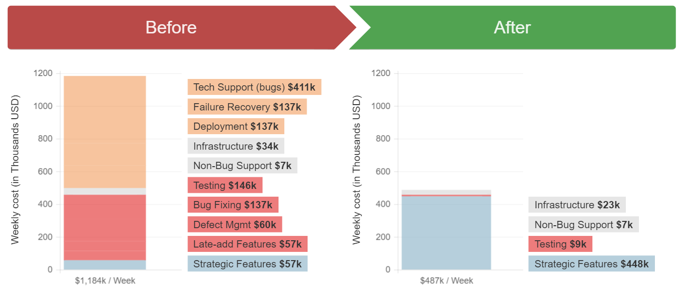
The #BugsZero Story: Why We Think We Care
Notes:
Holding cost of bugs

Slide 4
Why we Actually Care

Slide 5
Testers feel like

Slide 6
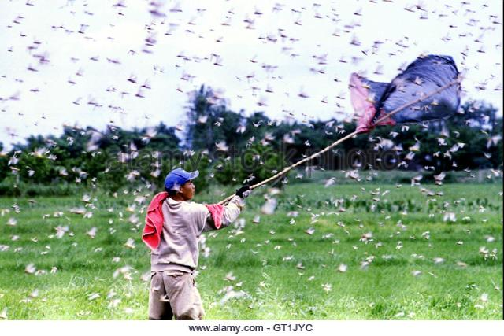

Slide 7
Product owners feel like

Slide 8
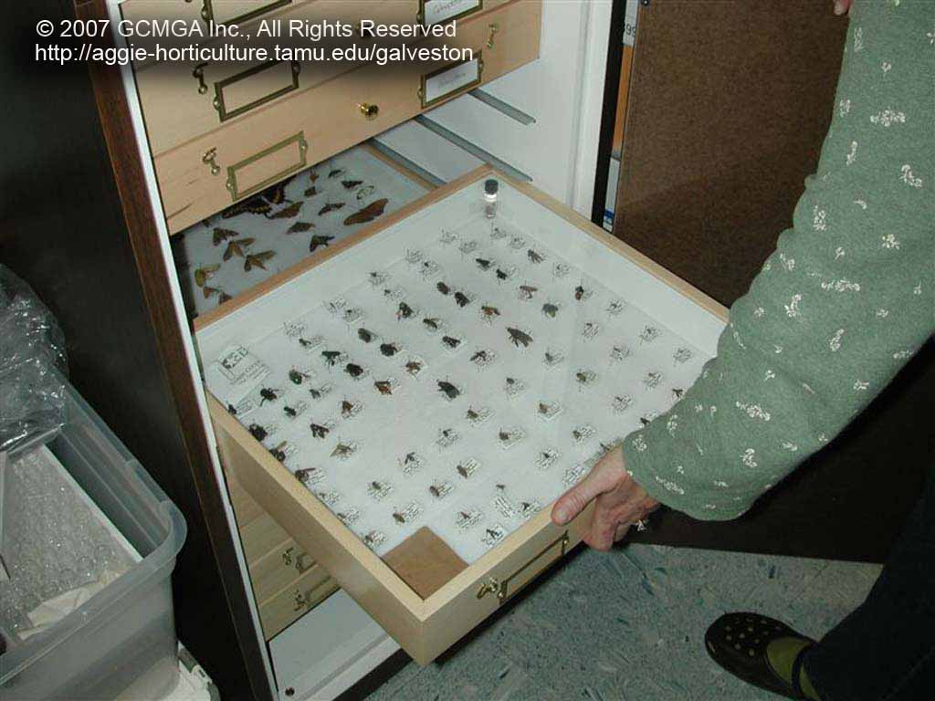

Slide 9
Developers feel like

Slide 10
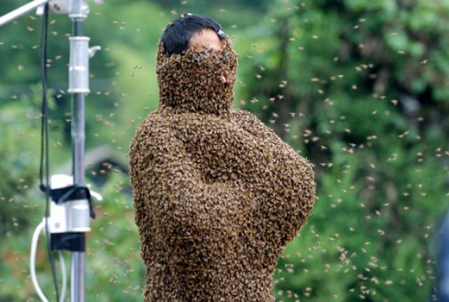

Slide 11
The architecture feels like

Slide 12
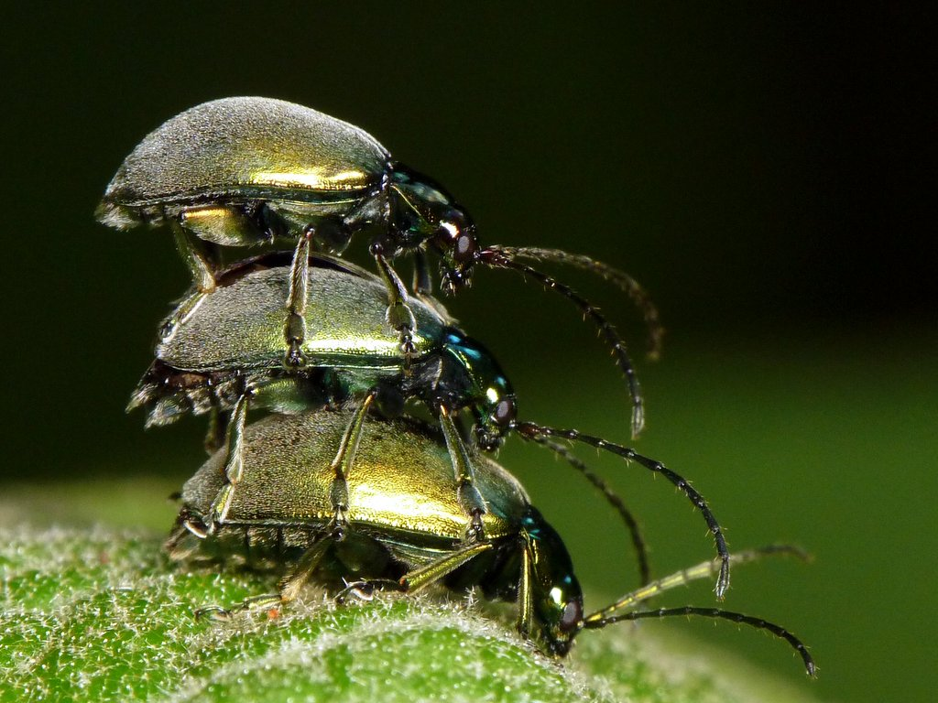

Slide 13
Operations feels like

Slide 14
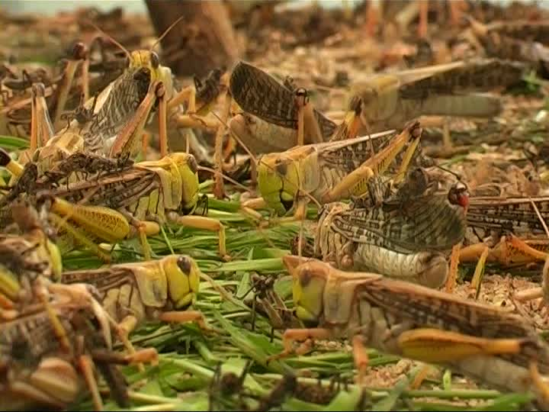

Slide 15
Sales has to pretend it is

Slide 16


Slide 17
But sales knows it actually is

Slide 18


Slide 19
Customers feel

Slide 20
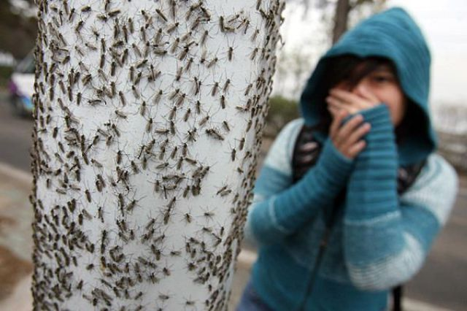

Slide 21
And execs feel

Slide 22
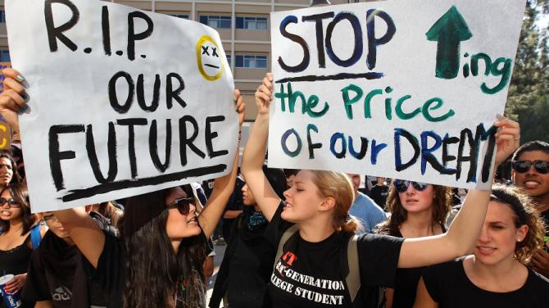

Slide 23

But I Don’t Have Technical Debt

Slide 24
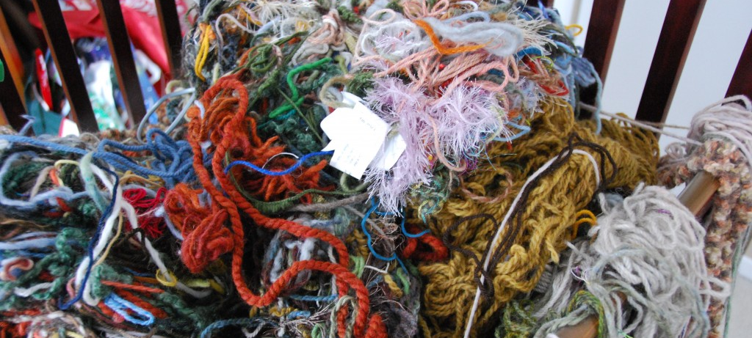
Good design + 30 years of careful changes
Notes:
Word team, decisions starting in late 80s

Slide 25
Quick Poll: How Many Bugs?
Function named DoContentHit
In service for 30+ years
26,000 lines
Uses undocumented system calls
Uses gotos liberally
Monitors keyboard and mouse
Need to add support for touch and pen

Slide 26
Quick Poll: How Many Bugs?
Function named DoContentHit
In service for 33+ years
18,000 lines, x2
Uses undocumented system calls
Uses gotos liberally, including jumps between functions
Monitors keyboard, mouse, touch and pen
Need to port to new OS, with different input devices

Slide 27
Bugs Annoy Me I Decided to Stop Having Them

Slide 28
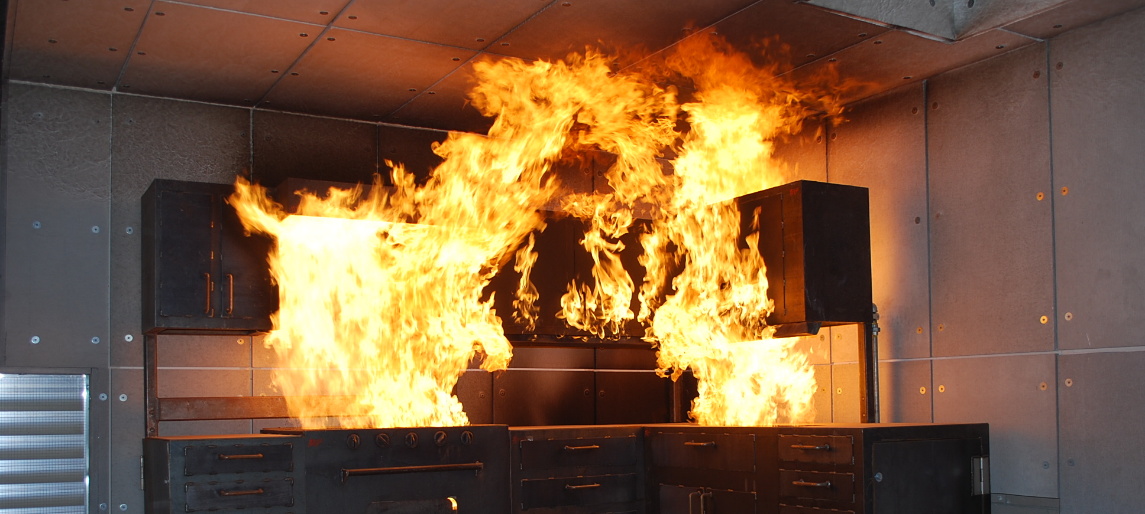
Bugs are Exciting Like Kitchen Fires

Slide 29
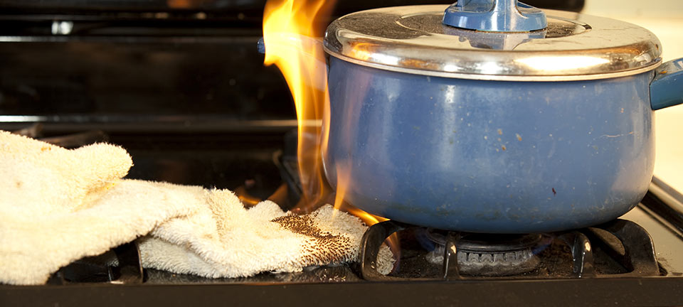
Fires Have Causes

Slide 30
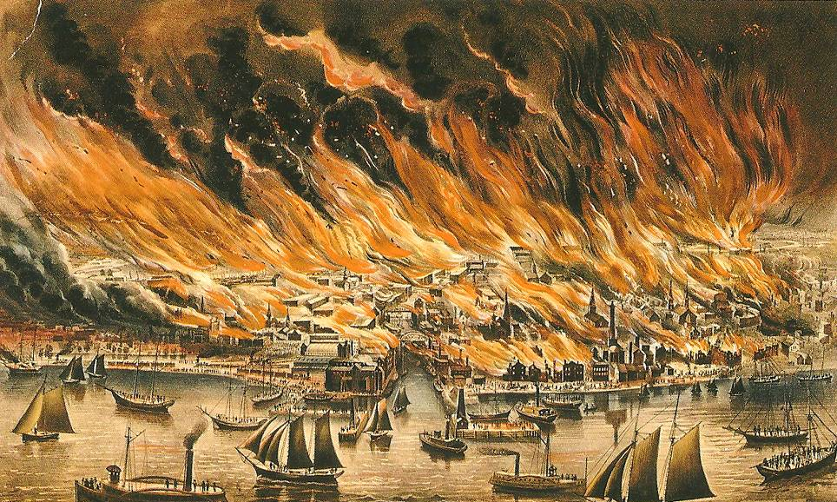
Caused by a cow?
Notes:
Truth: some kids gambling knocked over the lantern

Slide 31
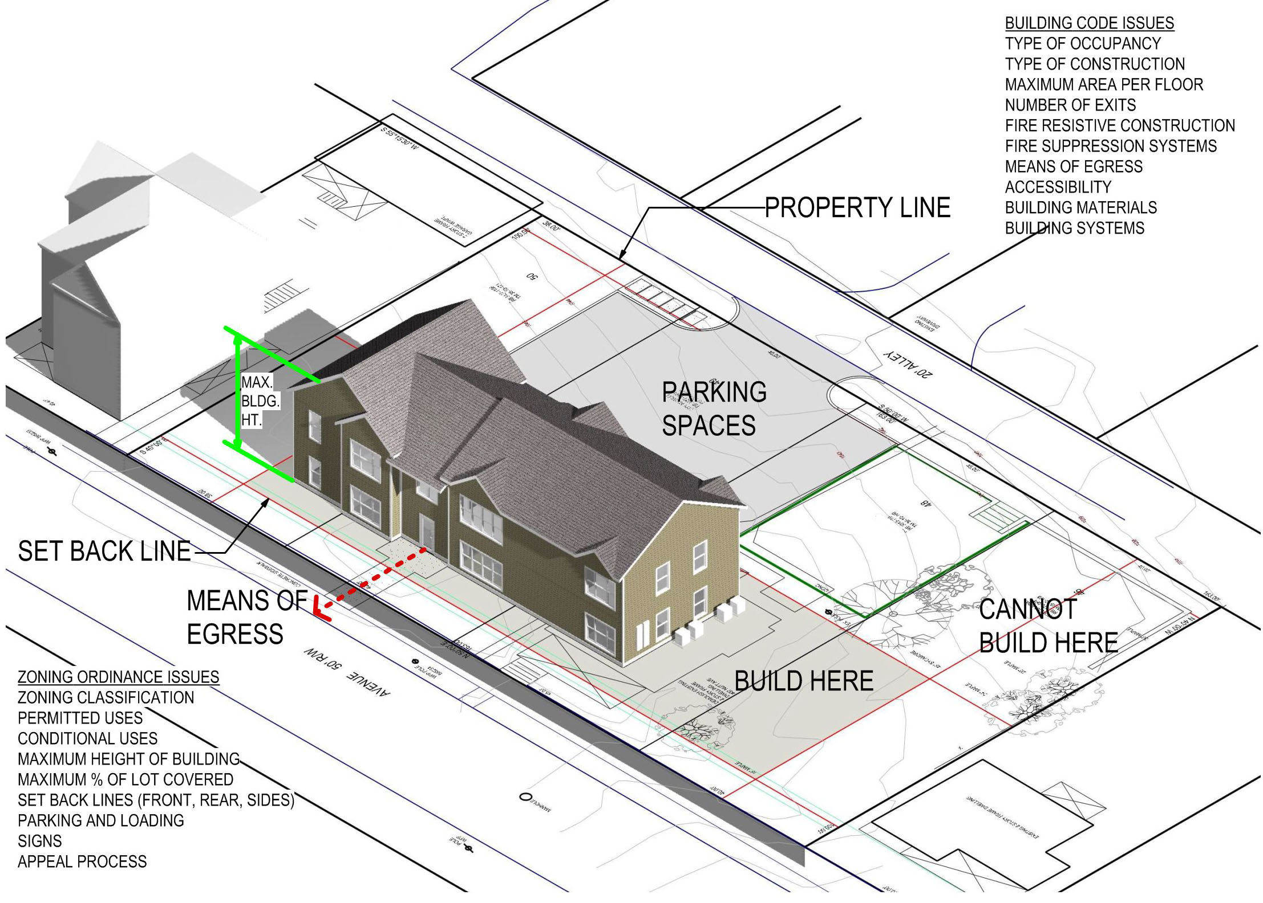
1,000,000 Fires Prevented

Slide 32
When people build a building, are they thinking about fire prevention?

Slide 33
How Do We Prevent Bugs?

Slide 34
To take an action for a fixed period of time, such that the probability of some undesirable outcome is permanently reduced.
Arlo
Definition of “Prevent”

Slide 35
Action + Context ======== Outcome

Slide 36
Action + Context + Spread ======== Outcome

Slide 37
Anything that would frustrate, confuse, or disappoint some human, and is potentially visible to any human other than the one who created it.
Arlo
Definition of “Bug”

Slide 38
Actions that Can Cause Bugs
Changing what a human receives
Coding
Designing
Changing what a human expects
Selling
Gaining insight about customer intent / need
Marketing
UI / UX
The world changing

Slide 39
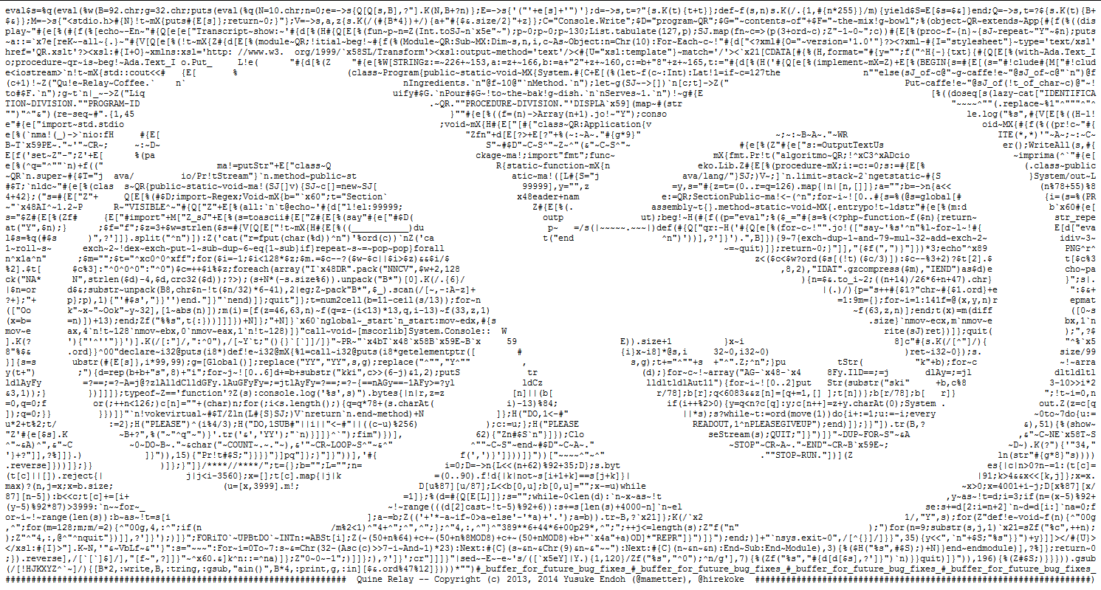



Contexts that Turn Those Actions Into Bugs
Unreadable code
Context sensitivity
Miscommunications between
customer and developer
Stuff developers don’t know

Slide 40

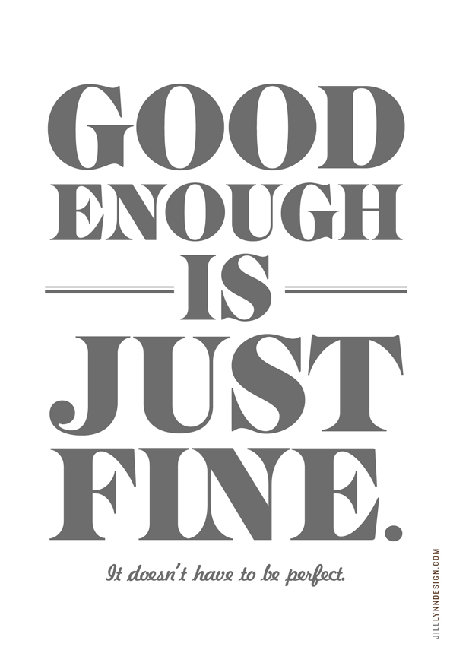
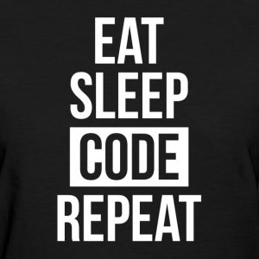

Situations that Spread Bugginess
Hurrying
Accepting Errors
Repeating Mistakes
High Risk of Change

Slide 41
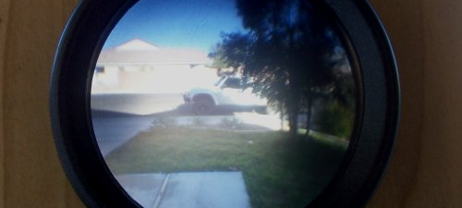
People Notice Little Habit Drives Most Actions

Slide 42

Bugs Don’t Come From What You Do
Notes:
They come from who you are.

Slide 43
How do we change the habits that set our results?

Slide 44
Unreadable Code
Read by Refactoring Habits
Insight Loop
Core 6 Refactorings
Rename to store insights
Extract Method to divide operations
Intro Variable / Param / Field to divide data
Inline to bring things together

Slide 45
Context Sensitivity
Dependency Elimination Principle
Dependency-Breaking Patterns
TDD alone doesn’t help much
Test by Refactoring Habits
Test as Spec
Acceptance Microtests
Design by Refactoring Habits
Replace Supplier with Supplies
Breaking up God Classes iteratively
Follow fields to find multiple responsibilities

Slide 46
What Developers Don’t Know
Pairing, Tripling, or Mobbing
Especially across roles
Micro-habits & Mind-shifts
Customer visits
Listen to the code

Slide 47
Miscommunication on Path from Customer to Developer
Shorten the path
Customer telemetry
Pair with technical support, on both coding and support cases

Slide 48
Hurrying
Prevent the obvious bugs with common causes
This is failure demand; it goes away when the failures go away

Slide 49
Accepting Errors
Count “days since last accident”
Eliminate triage
All bugs are more important than remaining features
Change incentives for PO

Slide 50
Repeating Mistakes
Immediate stop the line
Immediate 5-whys
15% solutions for each contributing factor, as tasks on the board
Priority:
Mitigate
Prevent this class of bugs
Fix the bug
Anything other than this bug

Slide 51
High Risk of Change
Disciplined Refactoring
Build / Measure / Learn
For product
For team capability
Roll back non-successful experiments
Simple design beats extensible design

Slide 52
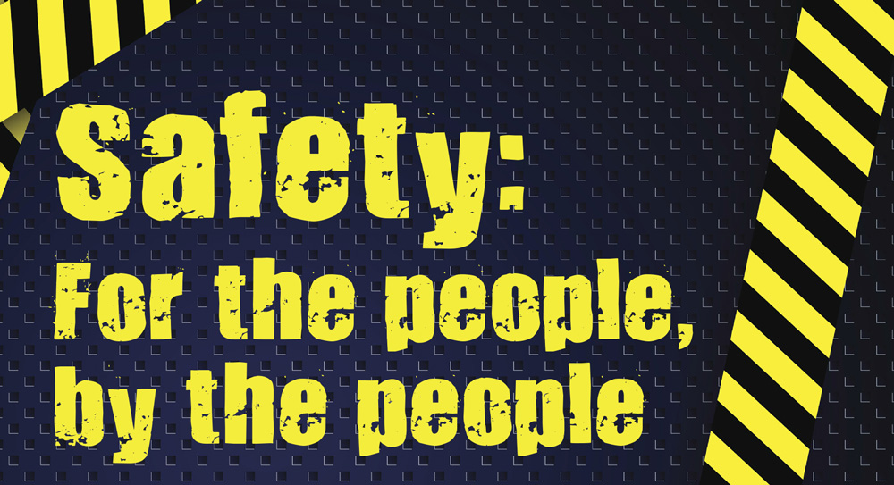
1. Fix the Environment that is causing errors

Slide 53
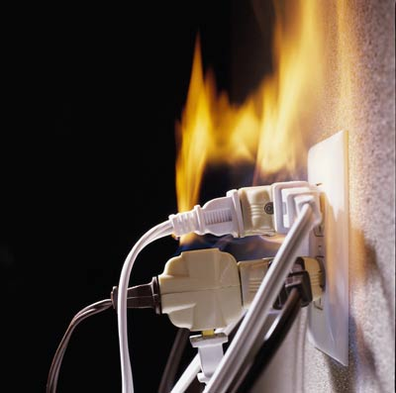
2. Learn from each bug to prevent more
Notes:
Nancy V. Global variables.
How many bugs do you think it caused? 1. Because they learned the cause and fixed the code.

Slide 54
DoContentHit (and its Application), 2 Subsequent Releases
Notes:
Holding cost of bugs

Slide 55
Thank You
http://bit.ly/PromiscuousPairingPdf
http://bit.ly/AgileEngineeringFluency
http://bit.ly/NamingIsAProcess
http://bit.ly/BugsZeroSlides (this talk)
@arlobelshee, github/arlobelshee, http://arlobelshee.com/

Slide 56
What do you think of when I say “bug free software?”
Most of us think about large testing efforts, TDD, find and fix early, “acceptable defect rate,” extremely expensive cleanroom development, long nights getting the last bugs out, or advanced canary deployment with auto-rollback.
That’s not what I mean at all.
When I say “bug free software,” I mean software that, when it is modified, results in developers naturally and without effort simply adding the intended behavior with no unanticipated side effects. Software as boring to write as it is to test.
Let’s talk about how teams across the world are writing software this boring. To get there we will have to deeply understand where bugs come from and what we can do to eliminate their breeding grounds, whether we start with new or existing code.

